Slide 1
ECE 471/571 – Lecture 3
Discriminant Function and Normal Density
08/27/14

Slide 2
Different Approaches - More Detail
Pattern Classification
Statistical Approach
Syntactic Approach
Supervised
Unsupervised
Basic concepts:
Baysian decision rule
(MPP, LR, Discri.)
Basic concepts:
Distance
Agglomerative method
Parametric learning (ML, BL)
k-means
Non-Parametric learning (kNN)
Winner-take-all
NN (Perceptron, BP)
Kohonen maps
Dimensionality Reduction
Fisher’s linear discriminant
K-L transform (PCA)
Performance Evaluation
ROC curve
TP, TN, FN, FP
Stochastic Methods
local optimization (GD)
global optimization (SA, GA)
ECE471/571, Hairong Qi

Slide 3
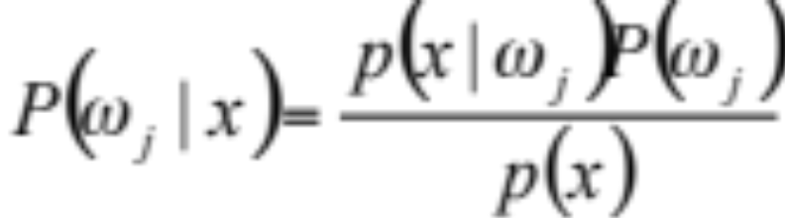
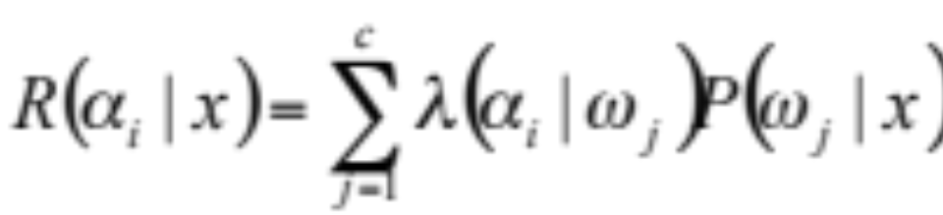
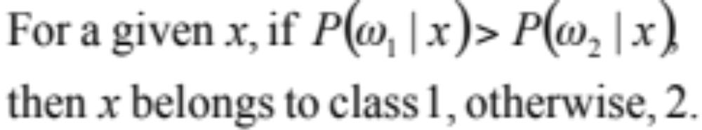
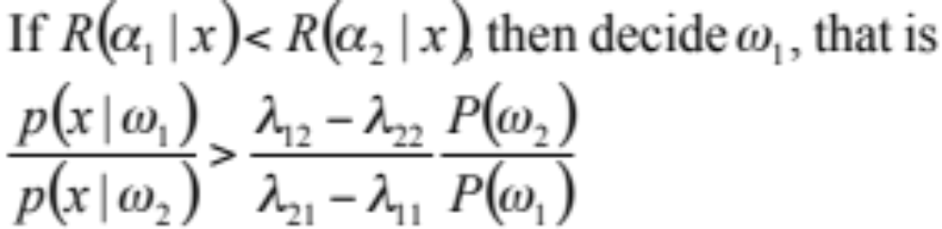
Bayes Decision Rule
Maximum
Posterior
Probability
Maximum
Likelihood

Slide 4
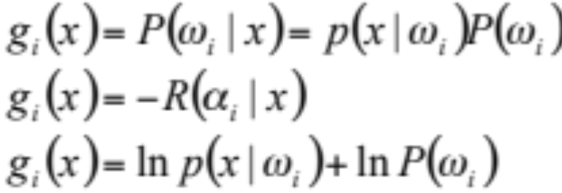
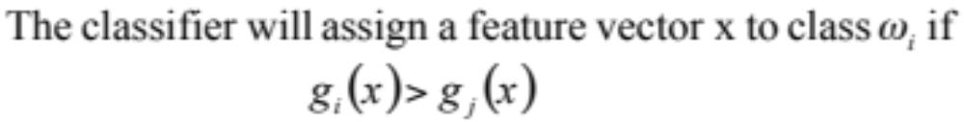
Discrimimant Function
One way to represent pattern classifier- use discriminant functions g_{i}(x)
For two-class cases,

Slide 5
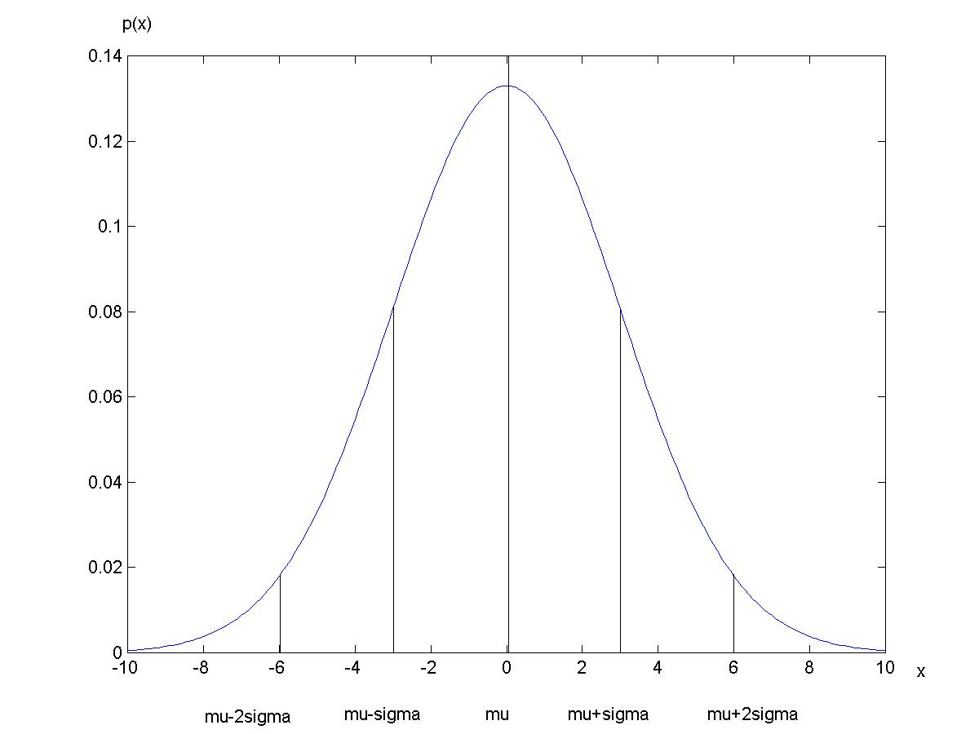
Normal/Gaussian Density
The 68-95-99.7
rule

Slide 6
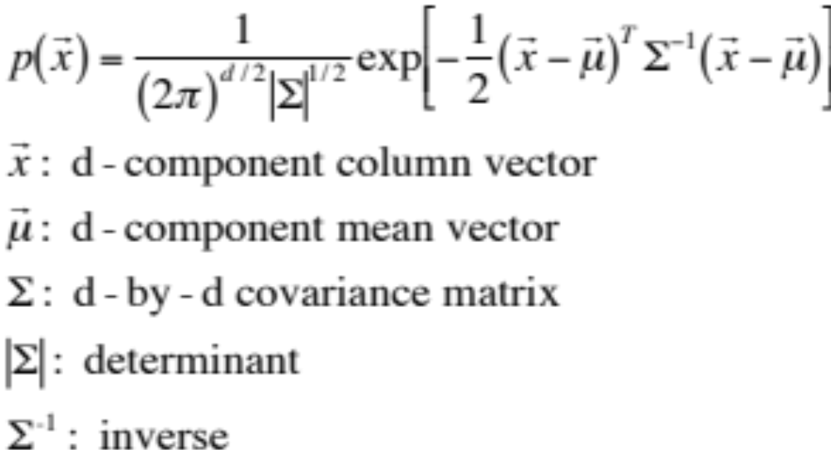
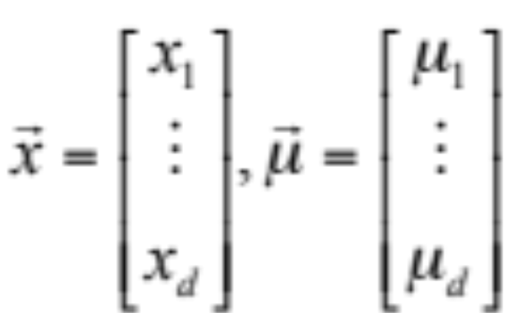
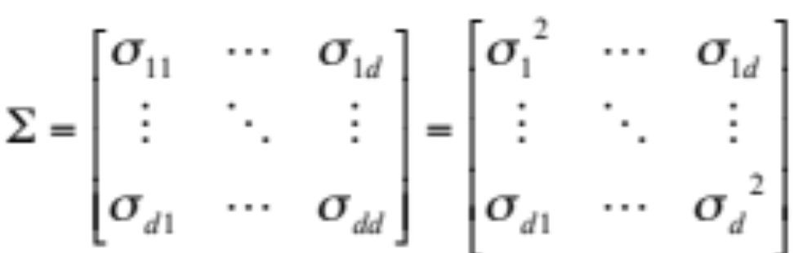
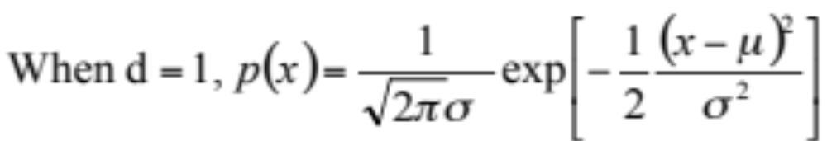
Multivariate Normal Density

Slide 7
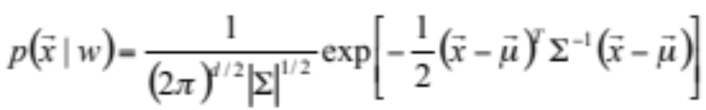
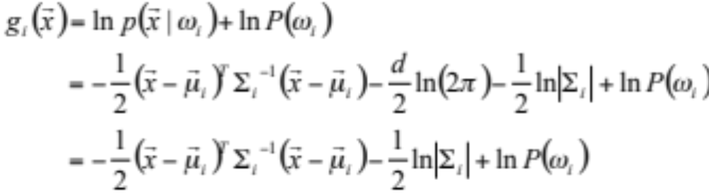
Discriminant Function for Normal Density

Slide 8
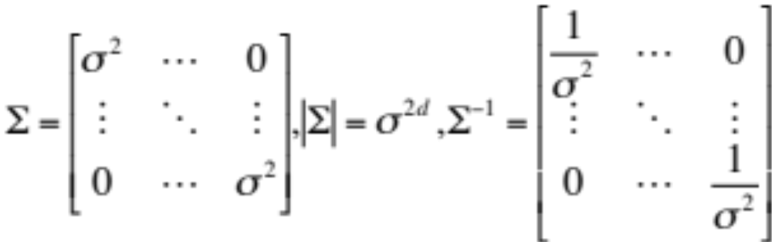
Case 1: Σ_{i}=σ²I
The features are statistically independent, and have the same variance
Geometrically, the samples fall in equal-size hyperspherical clusters
Decision boundary: hyperplane of d-1 dimension

Slide 9
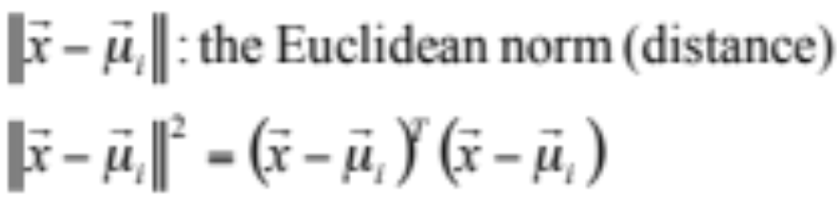
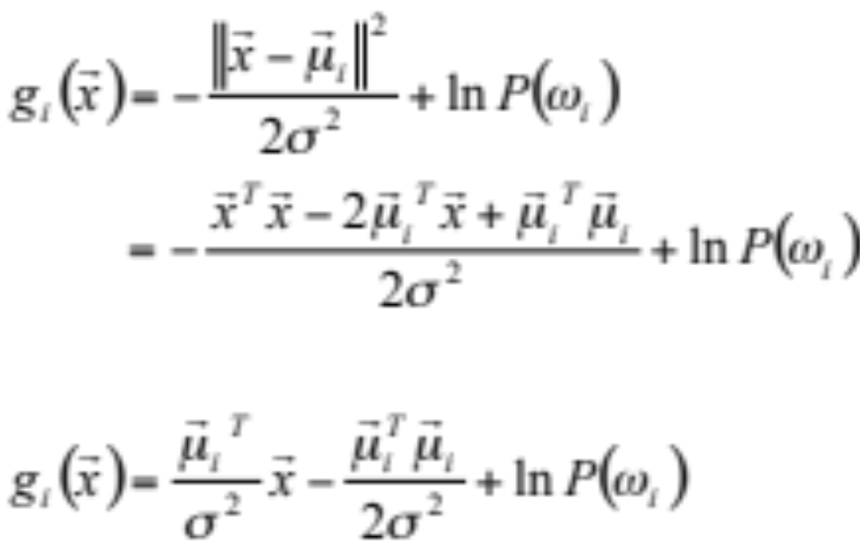
Linear Discriminant Function and Linear Machine

Slide 10
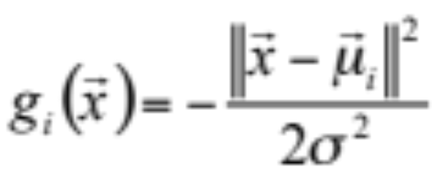
Minimum-Distance Classifier
When P(ω_{i}) are the same for all c classes, the discriminant function is actually measuring the minimum distance from each x to each of the c mean vectors

Slide 11
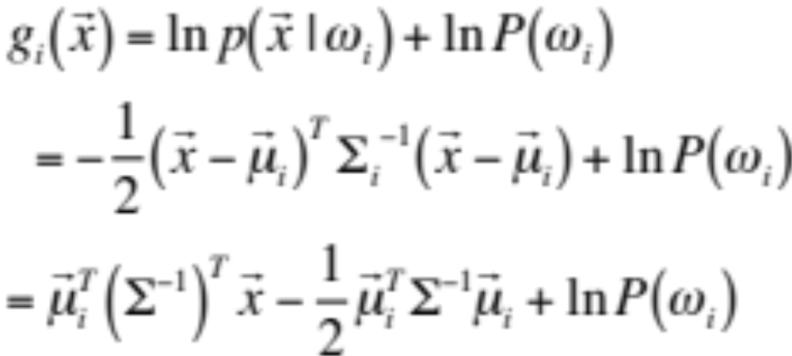
Case 2: Σ_{i} = Σ
The covariance matrices for all the classes are identical but not a scalar of identity matrix.
Geometrically, the samples fall in hyperellipsoidal
Decision boundary: hyperplane of d-1 dimension
Squared Mahalanobis distance

Slide 12
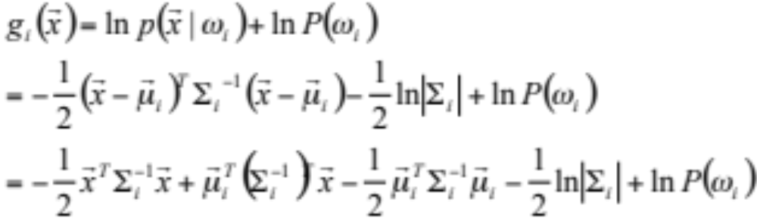
Case 3: Σ_{i} = arbitrary
The covariance matrices are different from each category
Quadratic classifier
Decision boundary: hyperquadratic for 2-D Gaussian

Slide 13
Case Study
a1 3.1 11.70 a
a2 3.0 1.30 a
a3 1.9 0.10 a
a4 3.8 0.04 a
a5 4.1 1.10 a
a6 1.9 0.40 a
b1 8.3 1.00 b
b2 3.8 0.20 b
b3 3.9 0.60 b
b4 7.8 1.20 b
b5 9.1 0.60 b
b6 15.4 3.60 b
b7 7.7 1.60 b
b8 6.5 0.40 b
b9 5.7 0.40 b
b10 13.6 1.60 b
c1 10.2 6.40 c
c2 9.2 7.90 c
c3 9.6 3.10 c
c4 53.8 2.50 c
c5 15.8 7.60 c
u1 5.1 0.4 b
u2 12.9 5.0 c
u3 13.0 0.8 b
u4 2.6 0.1 a
u5 30.0 0.1 o
u6 20.5 0.8 o
Calculate μ
Calculate Σ
Derive the discriminant function g_{i}(x)

